Slide 1
KEY CONCEPTS IN HISTORY

Slide 2
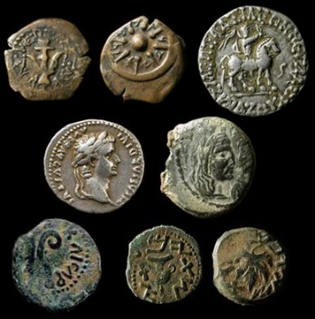
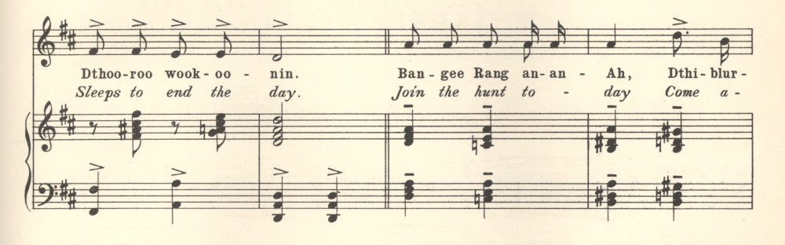
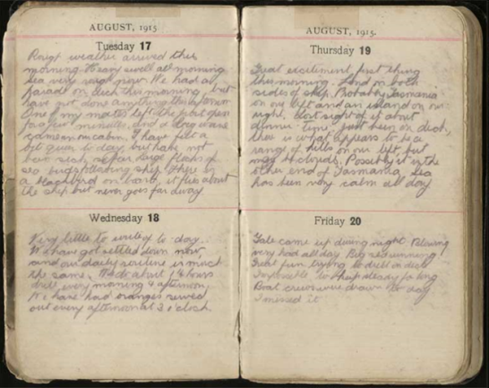
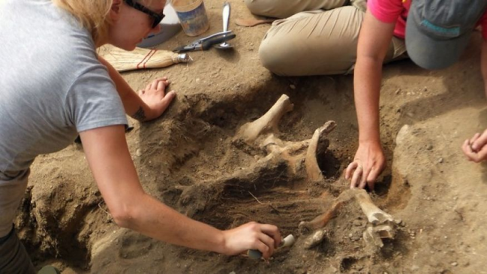
SOURCES AND EVIDENCE
Evidence is the information gathered from historical sources as we investigate the past.
There are two types of sources (primary and secondary)

Slide 3
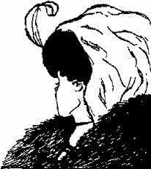
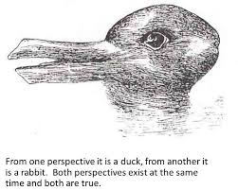
PERSPECTIVES
The position from which people see and understand events going on in the world around them.
E.g. Many people believe slavery is wrong, however it was accepted in Ancient Rome.

Slide 4
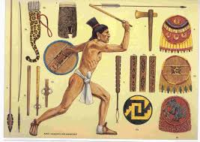
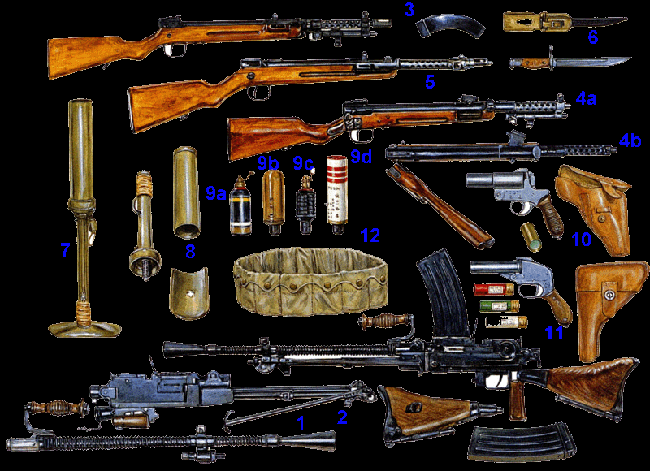
CONTINUITY AND CHANGE
Understanding that certain things (attitudes, processes, actions) change over time and certain things remain the same.
E.g. Hunting. We still do it, although we now have different weapons.

Slide 5
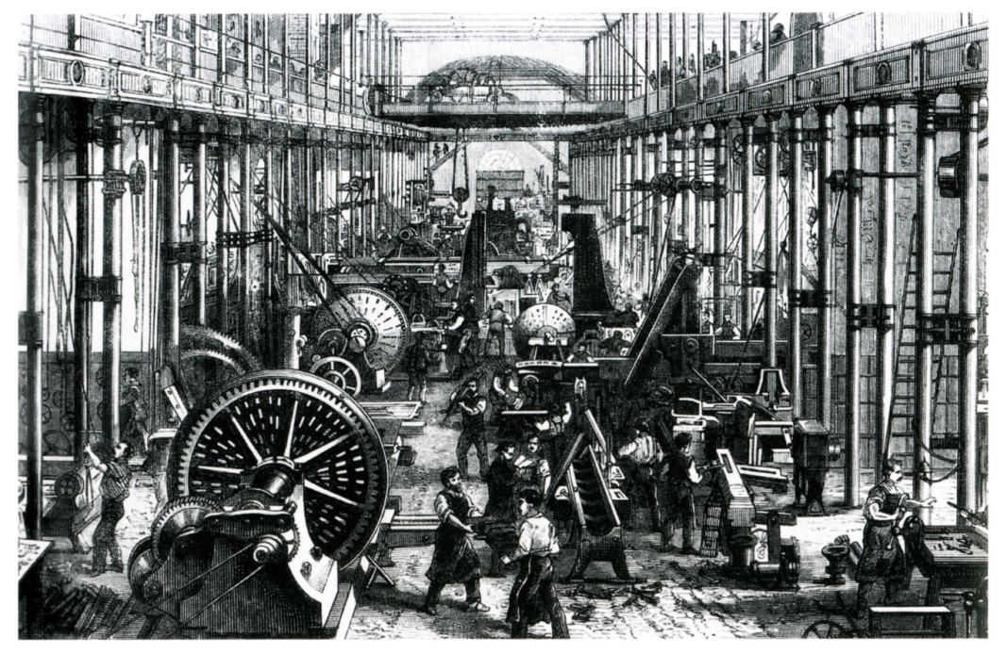
CAUSE AND EFFECT
Looking at the relationship between why events occur and what the results are.
There can be many causes of an event/action, which can lead to many effects.

Slide 6
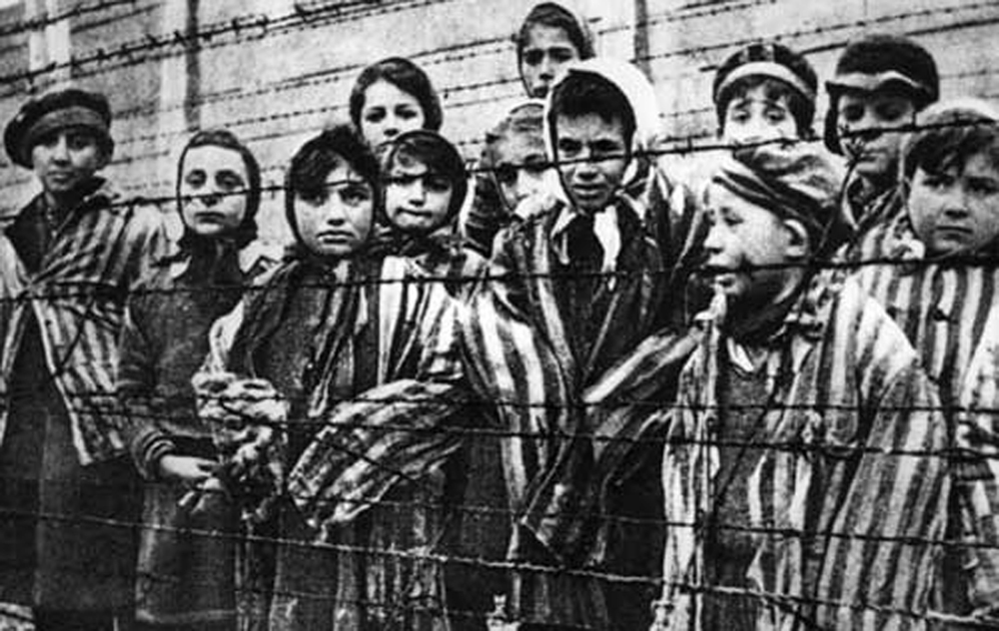

EMPATHY
Helps us understand the impact of past events on particular individuals or groups. It is the ability to ‘walk in someone else’s shoes.’

Slide 7
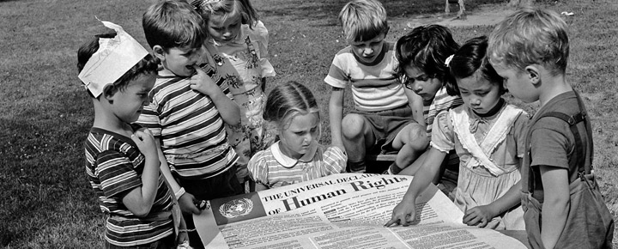
SIGNIFICANCE
Significance is the importance that is given to aspects of the past including discoveries, people, events and movements.

Slide 8
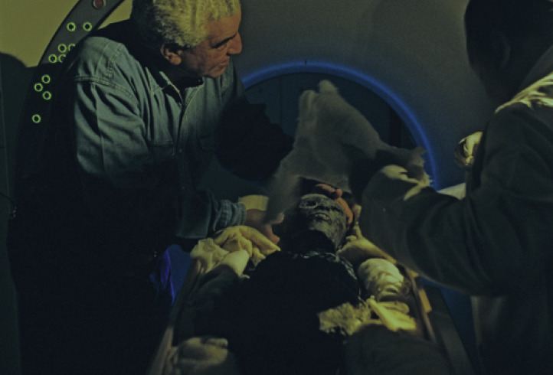
CONTESTABILITY
Explanations or interpretations of past events which are open to debate.
E.g. Historians debating how King Tutankhamun died.

